Slide 1
Feasibility of Beam Reinforcement Optimization for Practical Application
Advisor : Prof. K.C.Chang
Presenters : You-Ran Nai
Notes:
Try 講清楚脈絡

Slide 2
Outline
Part 2
Part 4
Methodology
Seismic Verification
Part 1
Part 3
Objective
Condition

Slide 3
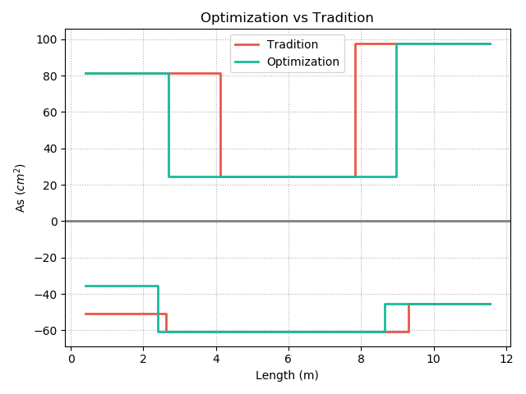
Top
12-#10
10-#10
REDUCE REBAR
3-#10
7-#8
9-#8
12-#8
Real
Demand
Bottom
Notes:
用最有感覺的圖

Slide 4
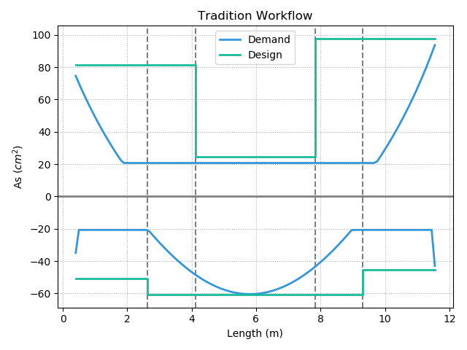
12-#10
10-#10
Today’s Solution
Fixed Bar-Cut
3-#10
10-#8
9-#8
12-#8
Notes:
LowSeismic4Floor12M 0

Slide 5
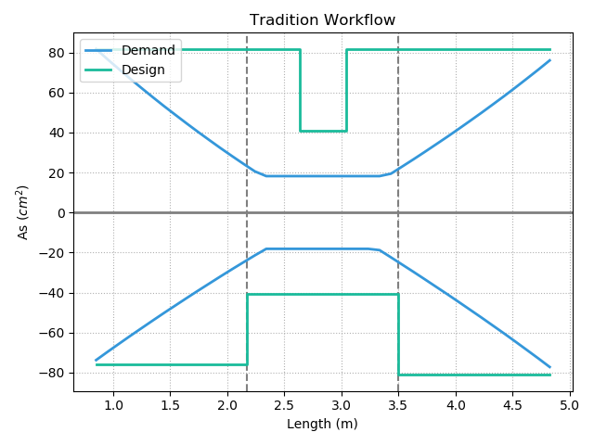
Today’s Solution
Notes:
欣銓 1140

Slide 6
Outline
Part 2
Part 4
Methodology
- Flexural
- Shear
Seismic Verification
Part 1
Part 3
Objective
Condition

Slide 7
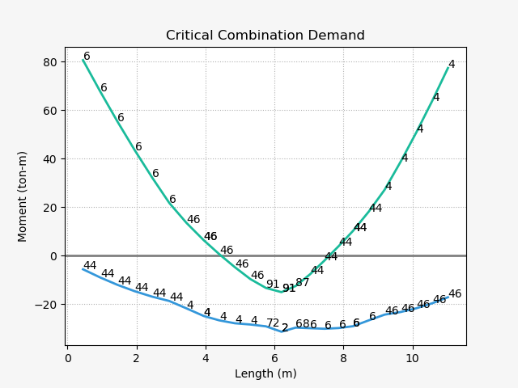
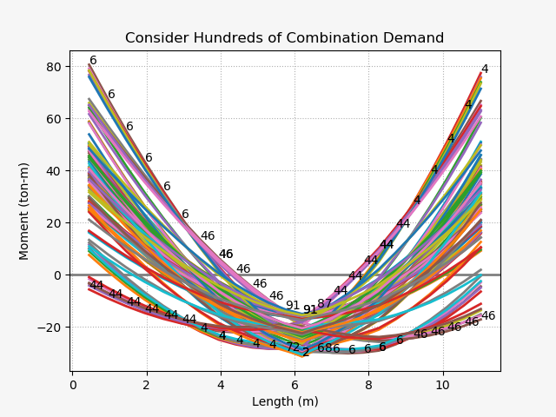
Design Moment - Mu
(1) U=1.4D
(2) U=1.2D + 1.6L
(3) U=1.2D + (1.0L or 0.5L)
(4) U=1.2D + 1.6W + (1.0L or 0.5L)
(5) U=1.2D + 1.0E + (1.0L or 0.5L)
(6) U=0.9D + 1.6W
(7) U=0.9D + 1.0E

Slide 8
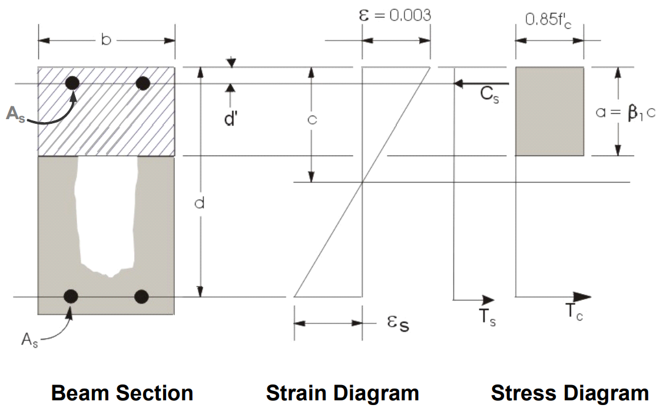
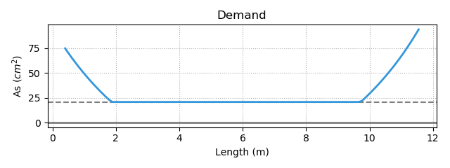
Flexural Reinforcement
- Demand As
Minimum Reinforcement
Notes:
LowSeismic 4Floor 12M 0

Slide 9
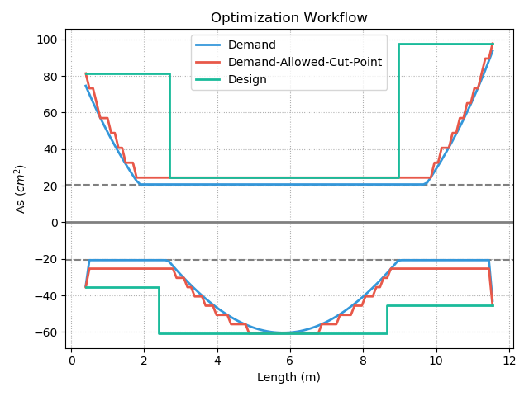
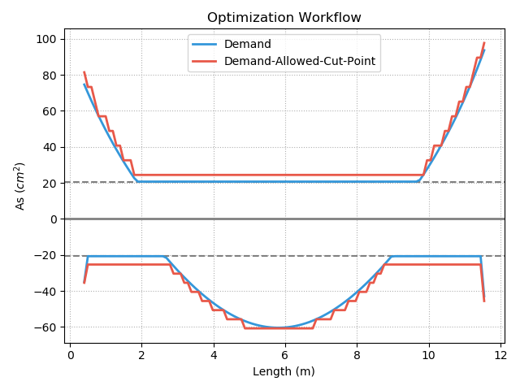
Procedure A

Slide 10
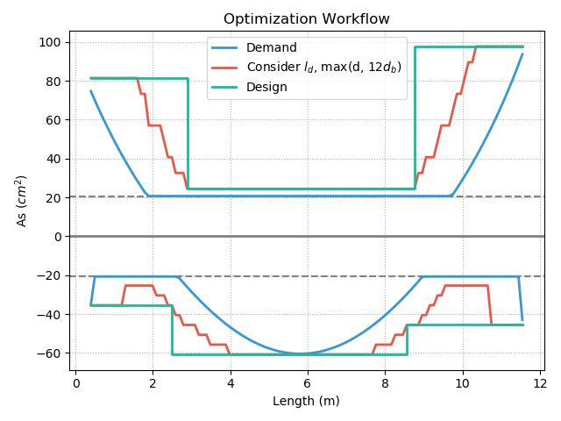
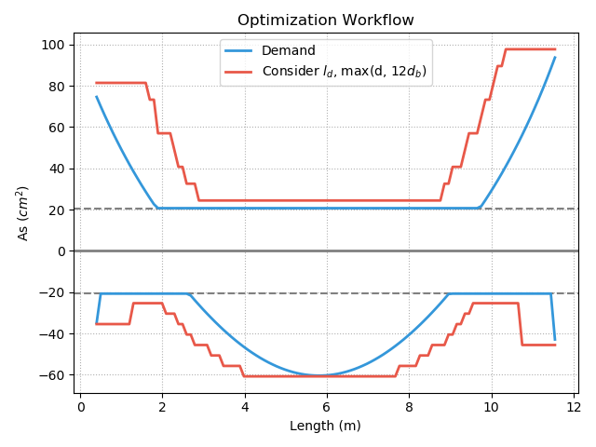
Procedure B

Slide 11
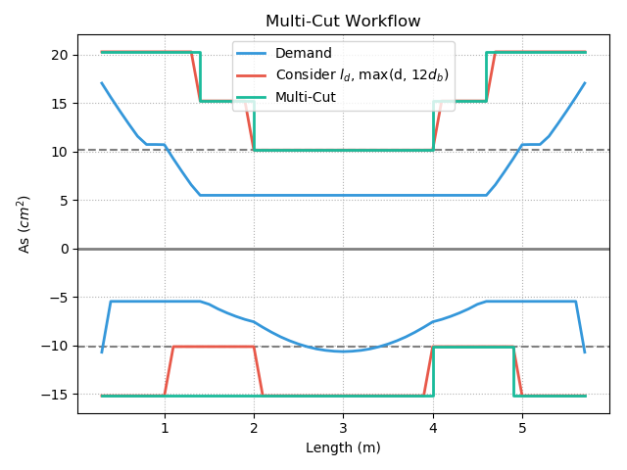
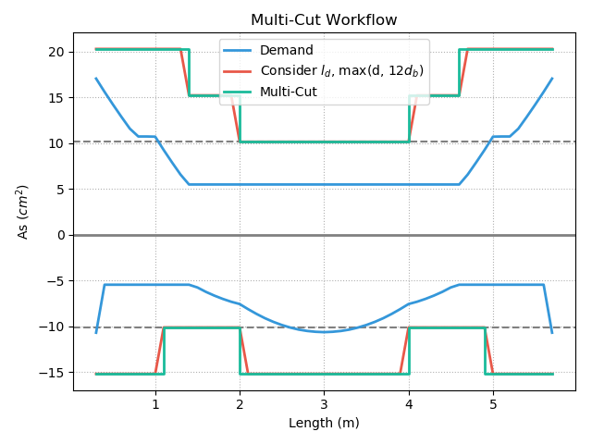
Multi-Cut
Top
Multi-Cut-4
Multi-Cut-2
Bottom
Notes:
GA 演算法
LowSeismic 4Floor 12M 4
LowSeismic 4Floor 12M 0

Slide 12
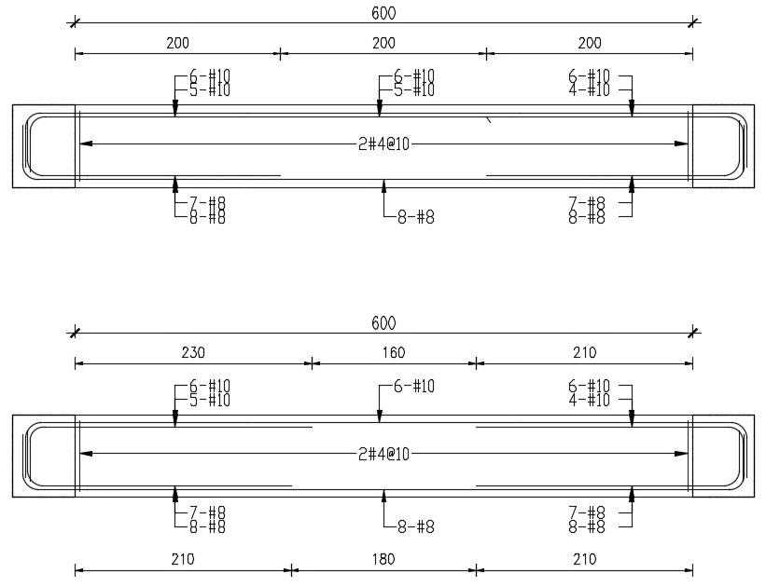
傳統梁鋼筋配置圖
最佳化梁鋼筋配置示意圖
Notes:
同第三頁的圖

Slide 13


Slide 14
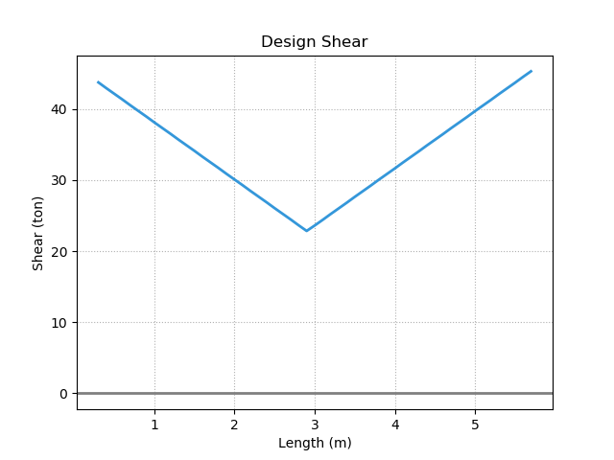
Design Shear - Vu
Notes:
LowSeismic4Floor12M 0

Slide 15
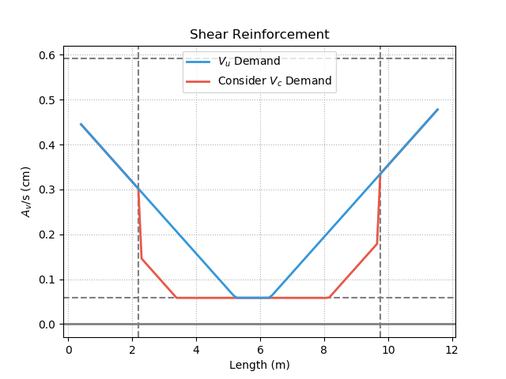
Shear Reinforcement
Notes:
LowSeismic4Floor12M 0

Slide 16
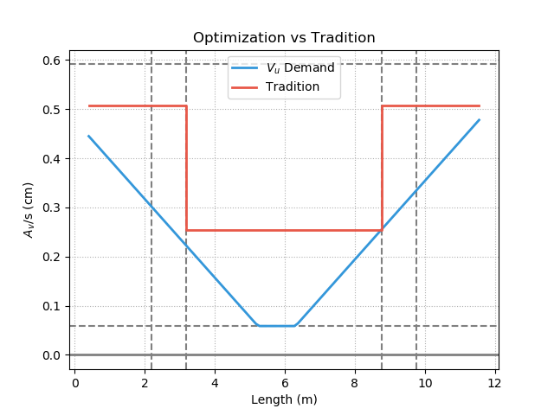
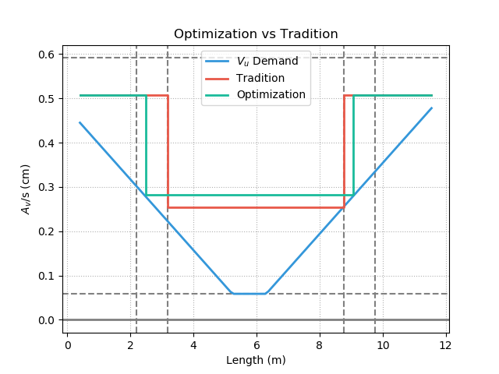
Shear Reinforcement
Notes:
LowSeismic4Floor12M 0

Slide 17
Outline
Part 2
Part 4
Methodology
Seismic Verification
Part 1
Part 3
Objective
Condition

Slide 18
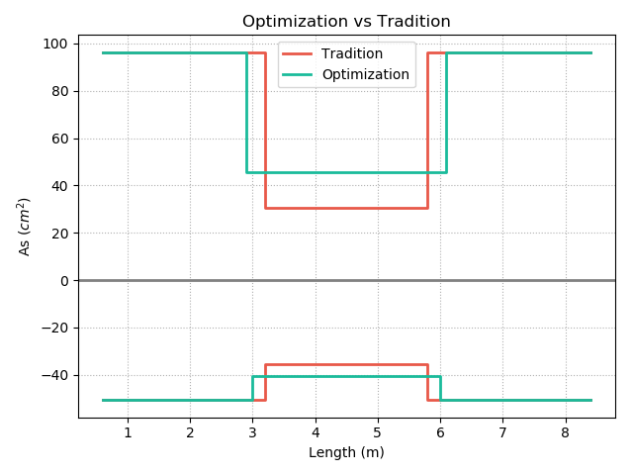
Optimization vs Tradition
12-#10
19-#8
19-#8
10-#10
3-#10
78%
6-#8
102%
94%
103%
7-#8
9-#8
7-#8
12-#8
10-#8
10-#8
Notes:
同第3頁

Slide 19
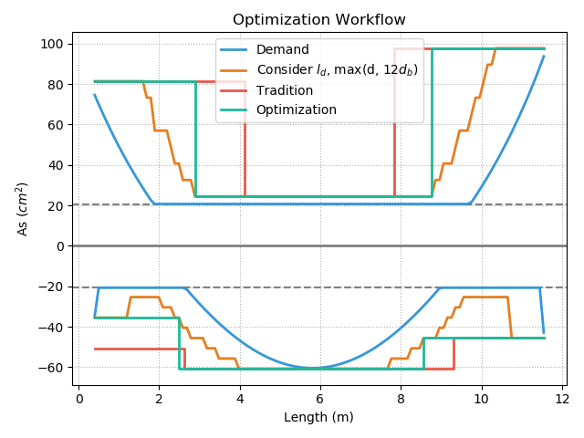
Factors
Moment
Tradition

Slide 20
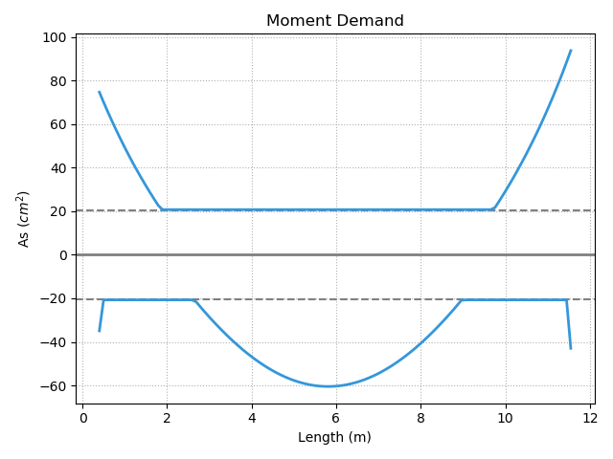
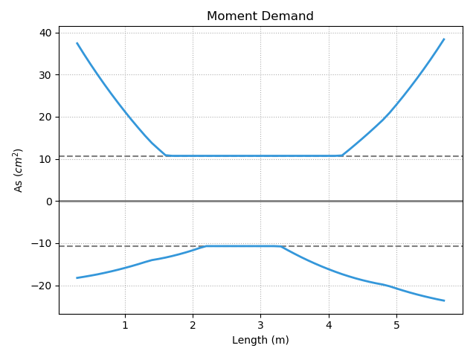
Moment Slope Large
Large Slope
Small Slope
Notes:
LowSeismic4Floor12M 0

Slide 21
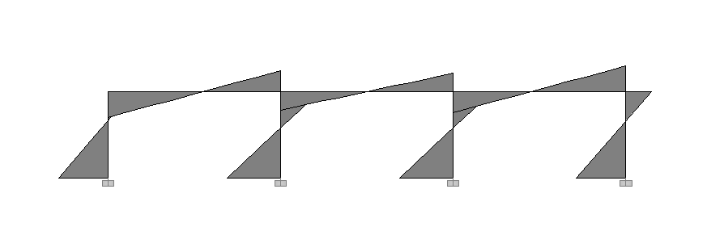
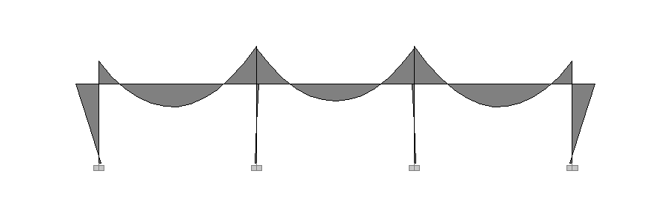
Large Slope
Lateral Load
Moment Diagram
Small Slope
Gravity Load

Slide 22
Moment Slope Large
Large Slope

Slide 23
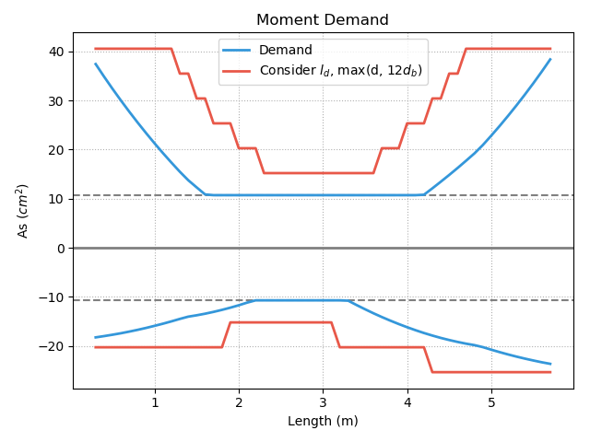
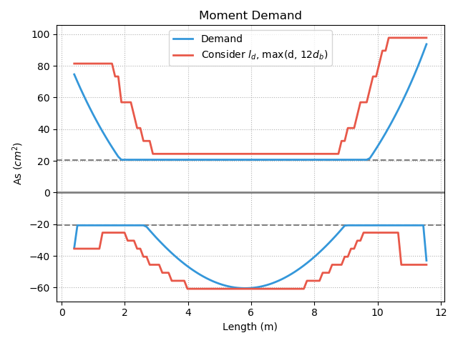
Short
Development Length
Notes:
LowSeismic4Floor12M 0

Slide 24
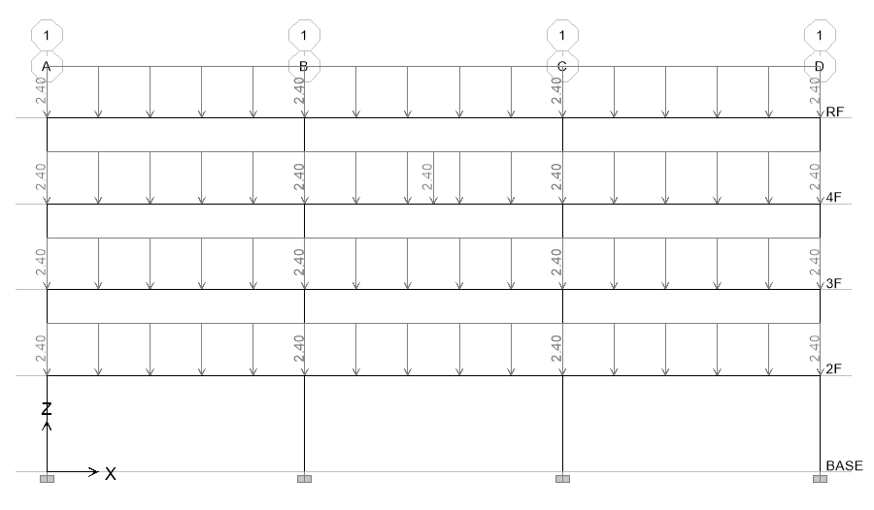
20 Models
4m
4.5m
Notes:
LowSeismic4Floor12M 0

Slide 25
Top Reinforcement

Slide 26
Bottom Reinforcement

Slide 27
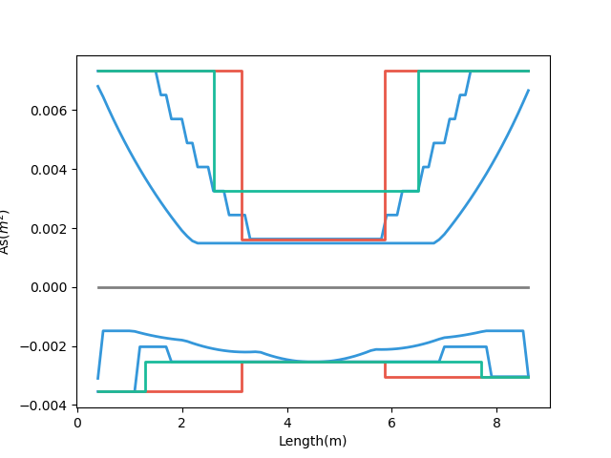
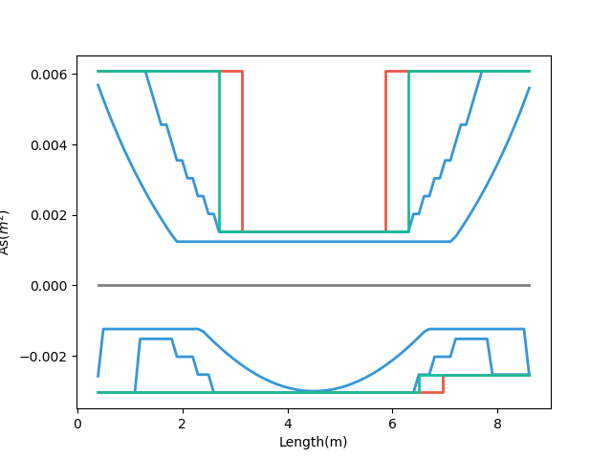
Why?
- Demand
- Tradition
- Multi-Cut-2
- Demand
- Tradition
- Multi-Cut-2
Small Gravity 89%
Bottom
Large Gravity 99%
5-#8
6-#8
5-#8
7-#8
6-#8
6-#8
High Seismic
Low Seismic
Notes:
HighSeismic 4Floor 9M 12
LowSeismic 4Floor 9M 12

Slide 28
Why?
- Demand
- Tradition
- Multi-Cut-2
- Demand
- Tradition
- Multi-Cut-2
Small Gravity 89%
Bottom
Large Gravity 99%
5-#8
6-#8
5-#8
7-#8
6-#8
6-#8
High Seismic
Low Seismic
Notes:
HighSeismic 4Floor 9M 12
LowSeismic 4Floor 9M 12

Slide 29
Total Reinforcement

Slide 30
#8 => #10 Reinforcement

Slide 31
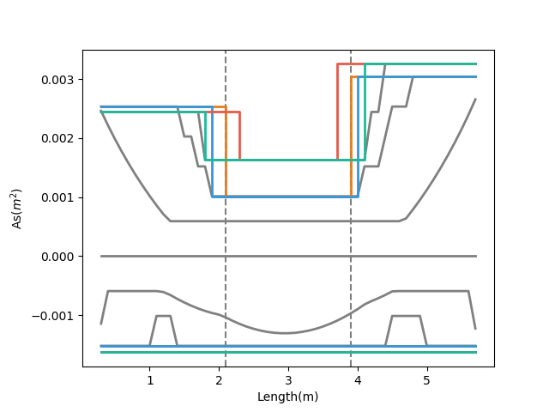
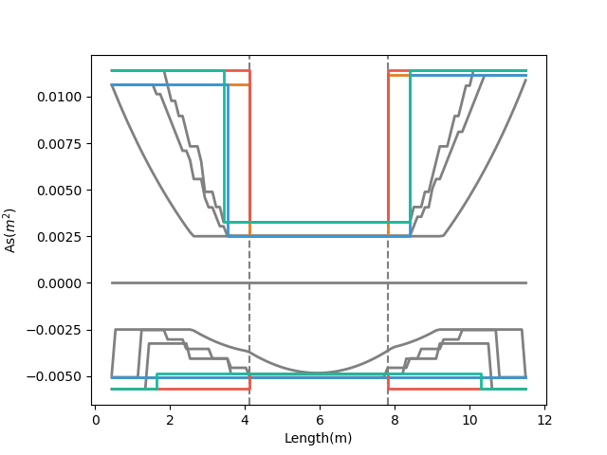
- Tradition, #8
- Tradition, #10
- Tradition, #8
- Tradition, #10
- Multi-Cut-2, #8
- Multi-Cut-2, #10
- Multi-Cut-2, #8
- Multi-Cut-2, #10
Notes:
MidSeismic 4Floor 6M 0
HighSeismic 4Floor 12M 12

Slide 32
Different Stories Reinforcement

Slide 34
Shear Reinforcement

Slide 35
Notes:
LowSeismic 4Floor 12M 0

Slide 36
More Multi-Cut
2
3
4
5
Unlimited
Notes:
理論最佳解

Slide 37
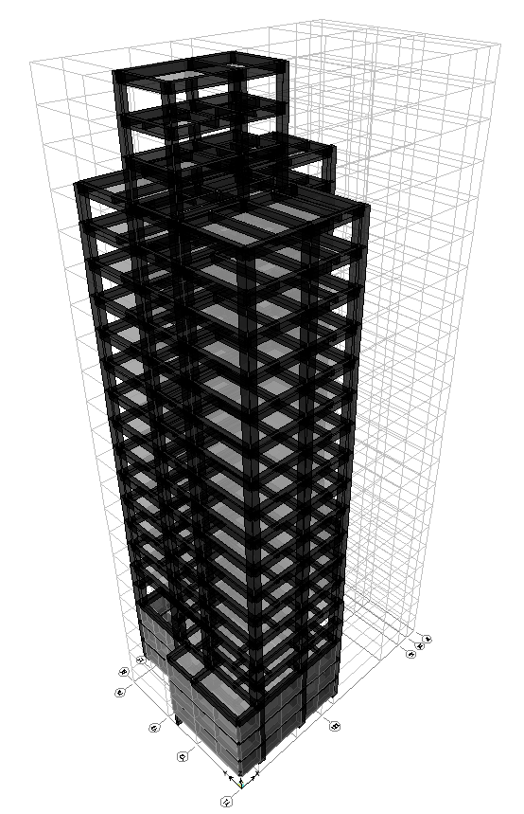
台北住宅案
100.0%
OVERALL RESULT
14F B3
101.3%
TOP RESULT
98.5%
BOT RESULT
20m
30m
Notes:
由於很複雜，先記得最終的結果
400

Slide 38
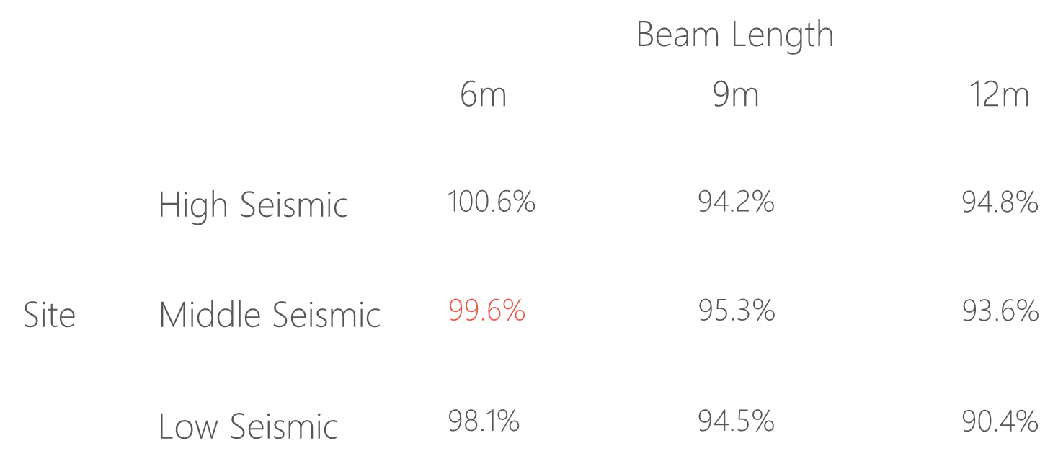
台北住宅案

Slide 39
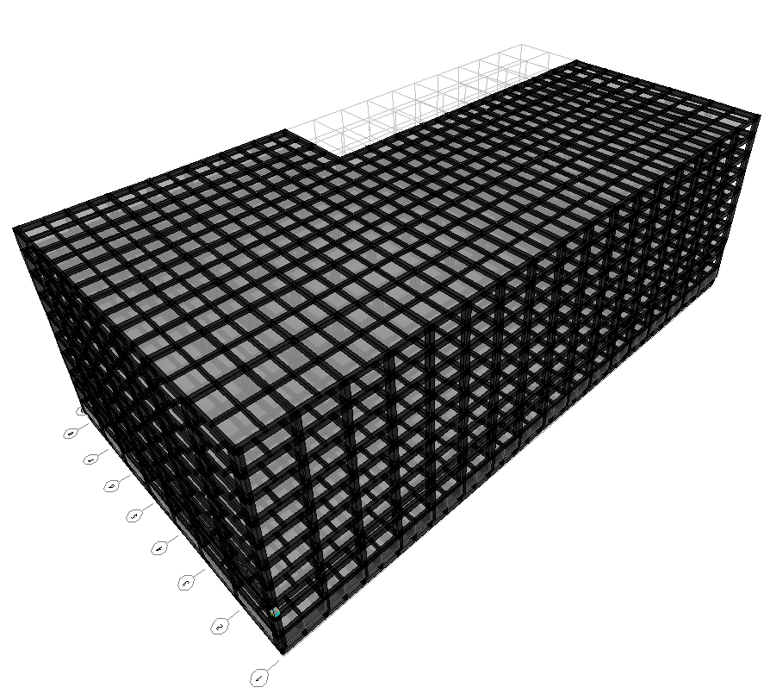
9F B1
93.4%
OVERALL RESULT
92.3%
TOP RESULT
153m
77m
94.7%
BOT RESULT
高雄物流中心
Notes:
3500

Slide 40
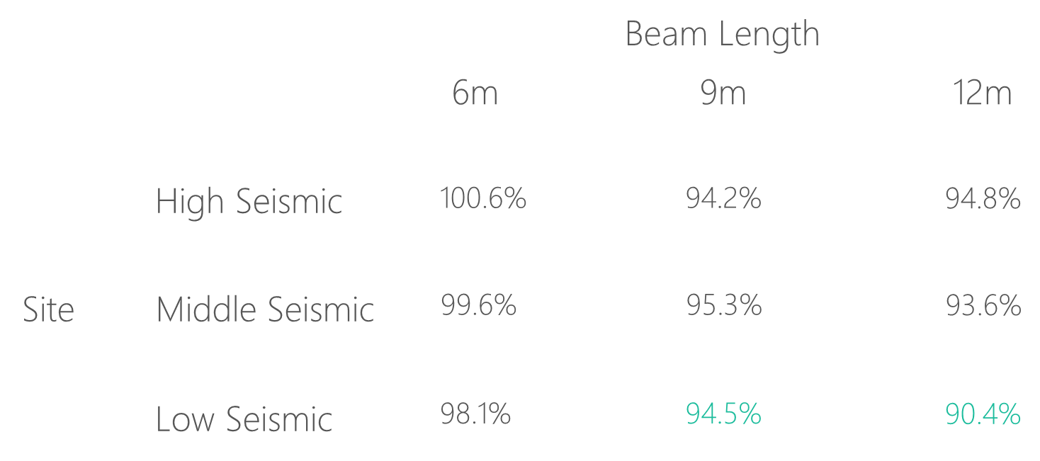
高雄物流中心

Slide 41
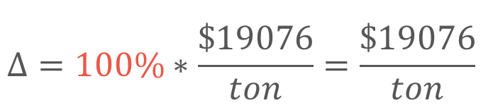
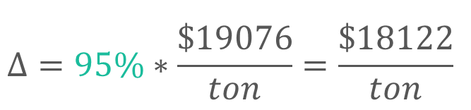
Material Cost
Tradition
Multi-Cut
$$Δ=100\%∗\frac{\$19076}{ton}=\frac{\$19076}{ton}$$
$$Δ=95\%∗\frac{\$19076}{ton}=\frac{\$18122}{ton}$$
Material Cost
Reduced Percentage
資料來源: 公共工程價格資料庫 2019

Slide 42
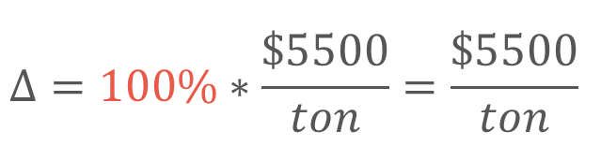
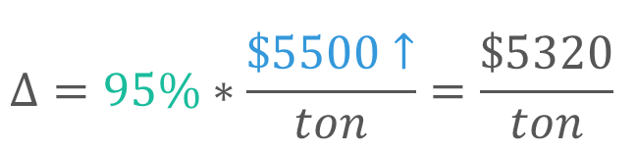
Construction Cost
Tradition
Multi-Cut
$$Δ=100\%∗\frac{\$5500}{ton}=\frac{\$5500}{ton}$$
$$Δ=95\%∗\frac{\$5500↑}{ton}=\frac{\$5320}{ton}$$
鋼筋綁紮工資
複雜度增加 => 鋼筋綁紮工資增加
資料來源: 台北市公共工程 2019

Slide 43

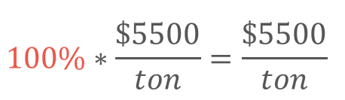

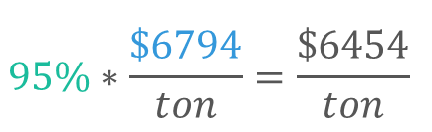
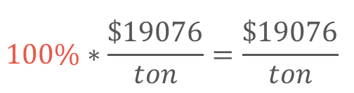
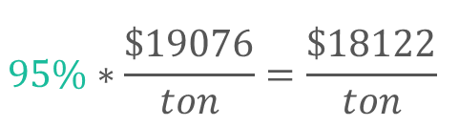
Cost Analysis
Tradition
Multi-Cut
$$100\%∗\frac{\$19076}{ton}=\frac{\$19076}{ton}$$
$$95\%∗\frac{\$19076}{ton}=\frac{\$18122}{ton}$$
Material Cost
Construction Cost
$$100\%∗\frac{\$5500}{ton}=\frac{\$5500}{ton}$$
$$95\%∗\frac{\$6794}{ton}=\frac{\$6454}{ton}$$
Total Cost
$$100\%$$
$$100\%$$

Slide 44
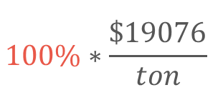

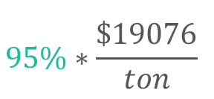
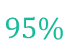
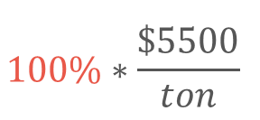
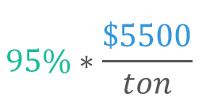
Cost Analysis
Multi-Cut-2
Tradition
Multi-Cut-2
$$100\%∗\frac{\$19076}{ton}$$
$$95\%∗\frac{\$19076}{ton}$$
Material Cost
Construction Cost
$$100\%∗\frac{\$5500}{ton}$$
$$95\%∗\frac{\$5500}{ton}$$
Total Cost
$$100\%$$
$$95\%$$

Slide 45
Outline
Part 2
Part 4
Methodology
Seismic Verification
Part 1
Part 3
Objective
Condition

Slide 46
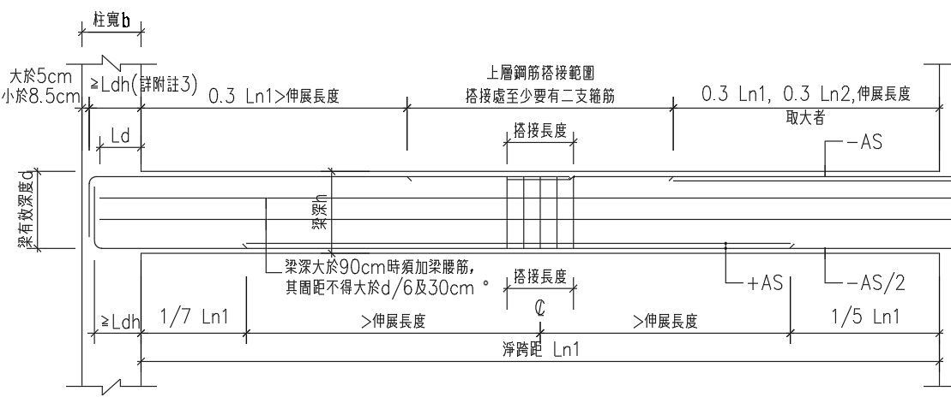
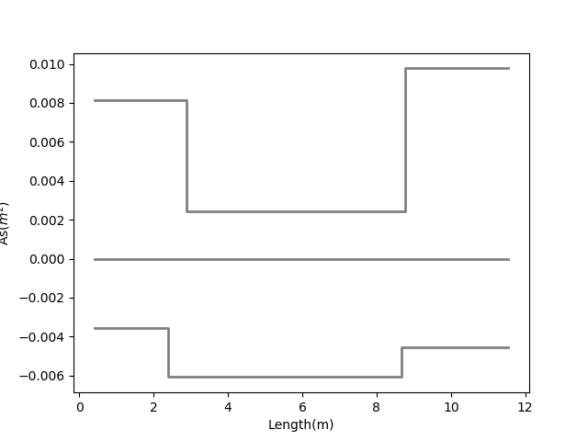
12-#10
Consider Ld
12-#10
10-#10
10-#10
Top
3-#10
3-#10
7-#8
7-#8
9-#8
Bottom
9-#8
12-#8
12-#8

Slide 47


Pushover Method
ATC-40 Capacity Spectrum
Modal Pushover Analysis
Multi-Modes Combination
Mode Shape
Effective Mass
SRSS
Notes:
定義非線性驗證的邊界

Slide 48
ATC-40 Capacity Spectrum
Tradition
Multi-Cut-2
Notes:
Low Seismic 12m 90.4%

Slide 49
Modal Pushover Analysis - Tradition
Mode 1
Mode 2

Slide 50
Modal Pushover Analysis – Multi-Cut
Mode 1
Mode 2

Slide 51
Modal Pushover Analysis - SRSS
Tradition
Multi-Cut-2

Slide 52
Multi-Modes Combination
Tradition
Multi-Cut-2

Slide 53




Step 2
Step 3
Step 5
Step 7

Slide 54
Gravity Load
Forth Hinge
Gravity Load
+
Lateral Load

Slide 55



Without Gravity Load
First Hinge

Slide 56

Time History Analysis
Story Drift
Scaled to DBE, MCE
- Time History Spectrum
- DBE Spectrum
- MCE Spectrum
DBE < 1.5%
MCE < 2%

Slide 57


DBE < 1.5%
Low Seismic 12m 90.4%
Tradition
Multi-Cut-2

Slide 58


MCE < 2.0%
Low Seismic 12m 90.4%
Tradition
Multi-Cut-2

Slide 59




Tradition DBE
Multi-Cut-2 DBE
換圖
Tradition MCE
Multi-Cut-2 MCE
Notes:
DBE 1602 11.5
MCE 1116 15.5

Slide 60





Slide 61


Incremental Dynamic Analysis
Single Static Analysis
➔
Incremental SPO
Single Time History Analysis
➔
Incremental One

Slide 62

Non-Linear SPO
Elastic
➔
Match
Non-Negative
➔
Equal Displacement
Negative
➔
Softening

Slide 63

Pushover and IDA too much difference

Slide 64


Another way IM: Base Shear

Slide 65
SF: 0.5
SF: 2.5
SF: 4.5
SF: 6.5
SF: 8.5
SF: 10

Slide 66

Result

Slide 67


Limit-State
4% FEMA273
2.5% SEAOC2000

Slide 68


IDA
Low Seismic 12m 90.4%
Log

Slide 69
Conclusion
Condition
Verification
Long Span
Low Seismic
Capacity Close To Tradition
Objective
Construction
Reduce Rebar
Today or Future Cost

Slide 70





Mu
Consider Hundreds Of Combo Demand
Critical Demand Combo
$$A_{s}({cm}^{2})$$
$$A_{s}({cm}^{2})$$
Length(m)
Length(m)

Slide 71


Design Moment - Mu
(1) U=1.4D
(2) U=1.2D + 1.6L
(3) U=1.2D + (1.0L or 0.5L)
(4) U=1.2D + 1.6W + (1.0L or 0.5L)
(5) U=1.2D + 1.0E + (1.0L or 0.5L)
(6) U=0.9D + 1.6W
(7) U=0.9D + 1.0E

Slide 72


Design Moment - Mu
(1) U=1.4D
(2) U=1.2D + 1.6L
(3) U=1.2D + (1.0L or 0.5L)
(4) U=1.2D + 1.6W + (1.0L or 0.5L)
(5) U=1.2D + 1.0E + (1.0L or 0.5L)
(6) U=0.9D + 1.6W
(7) U=0.9D + 1.0E

Slide 73




General Development Length Equation
Procedure A
MIN
Simplified Provisions

Slide 74
General Development Length Equation
Procedure A
MIN
Simplified Provisions

Slide 75

傳統梁鋼筋配置圖
最佳化梁鋼筋配置示意圖
Notes:
LowSeismic 4Floor 12M 0

